Slide 1

EECT 121 Lab Notebook
ELECTRONIC PROJECTS
Spring 2015
Ken Fischer
Eh Doh Lwe
5-5-15

Slide 2

Table of Contents
Diode 3
Diode Rectifier 7
Bipolar Junction Transistors 10
BJT Amplifier Circuits 14
Field-Effect Transistors and Circuits 17
Operation Amplifier 19
Oscillator 23
Silicon-Controlled Rectifier (SCR) 26

Slide 3
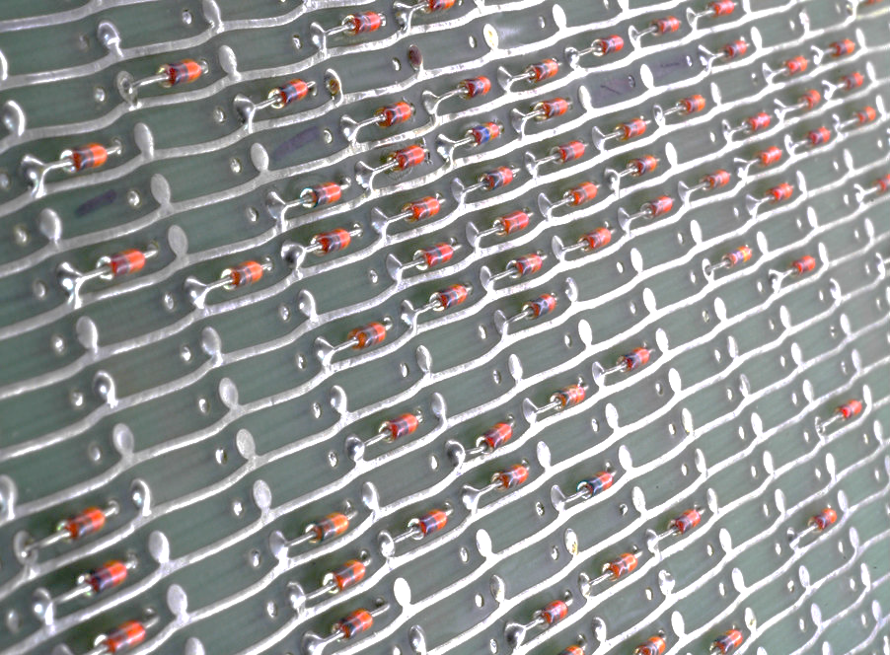
Diode

Slide 4

Diode
Objective
To understand how diode works.
Equipment and Material
Function Generator, Oscilloscope, various diode, and 1k resistors
Research and Information
https://www.youtube.com/watch?v=OyC02DWq3mI

Slide 5
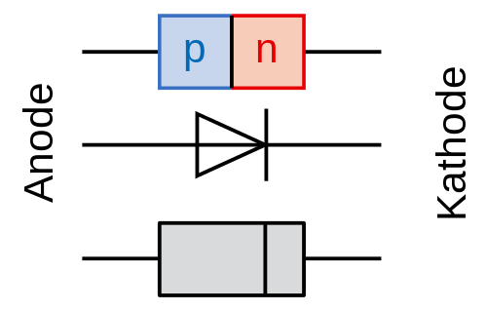
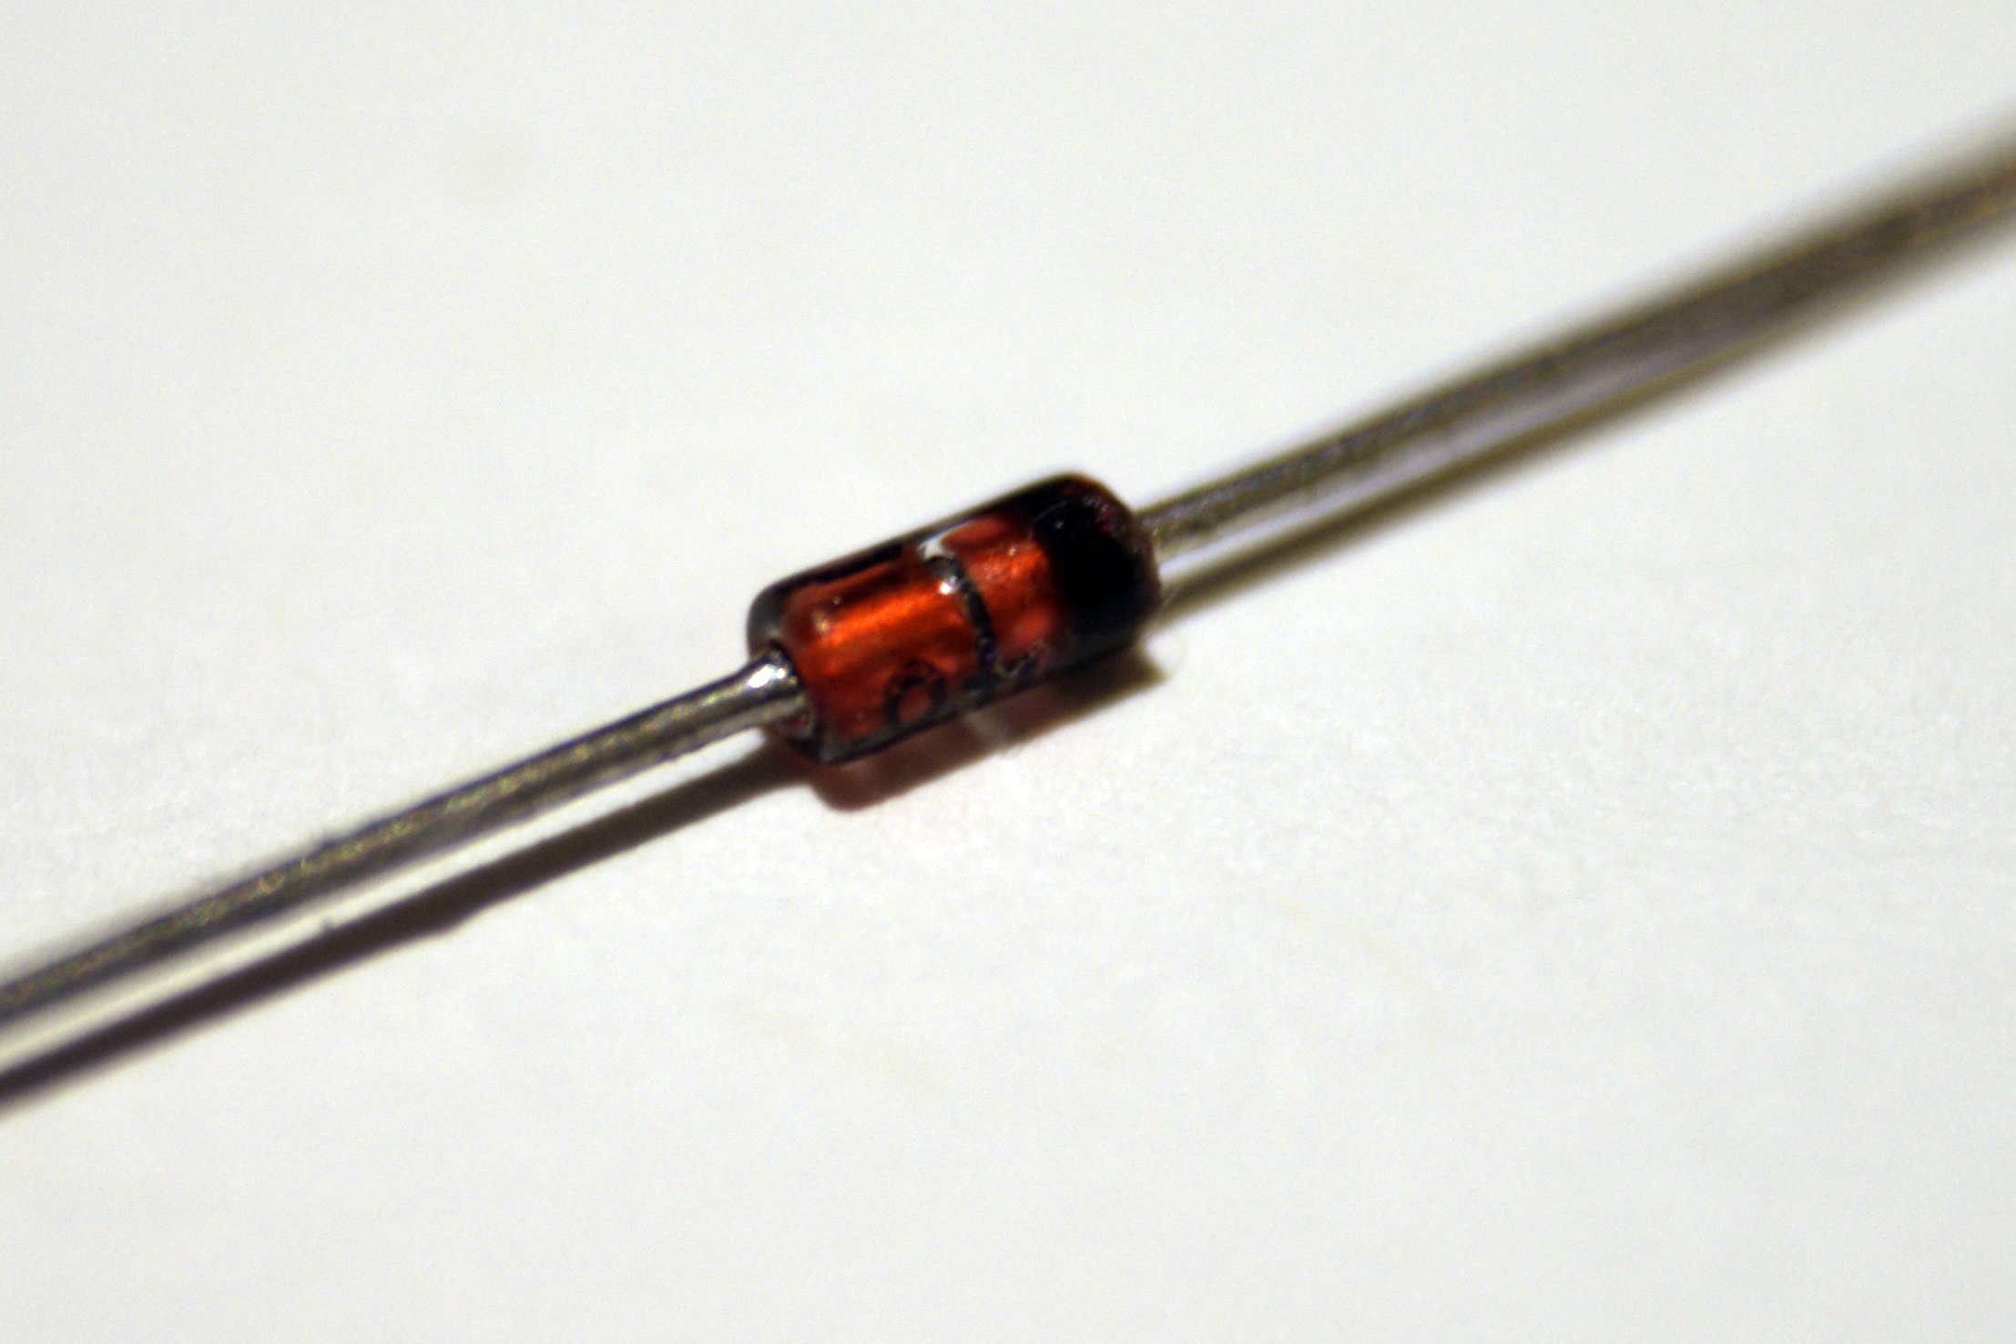
Diode Details

Slide 6
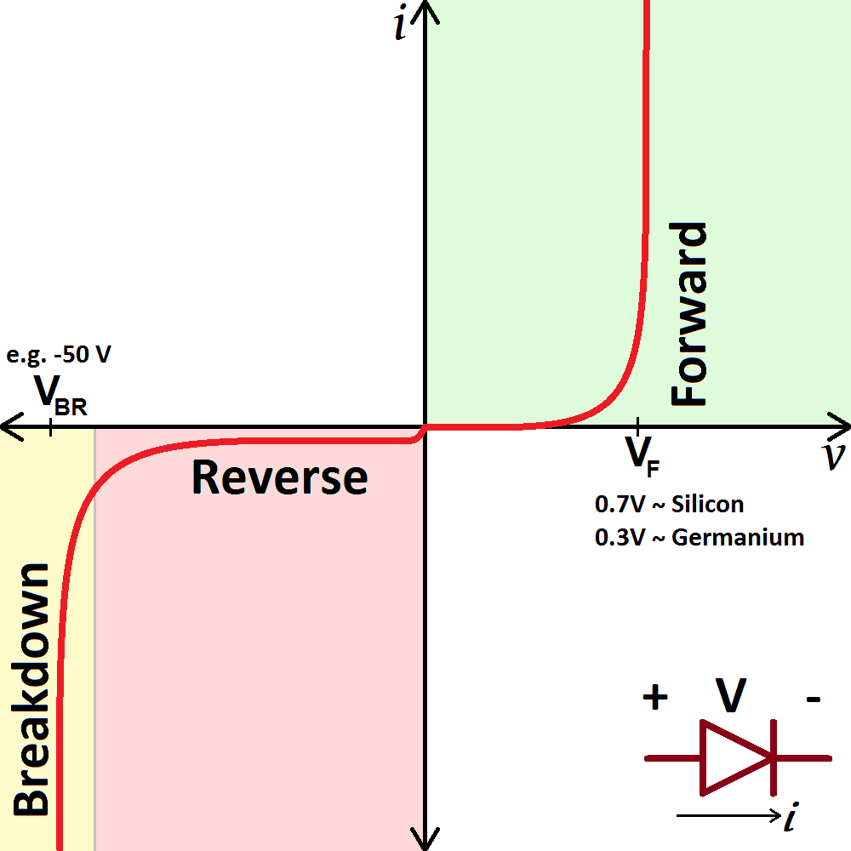
Diode
Summary and Conclusion
Biased in one direction
Voltage drop of .7v
Reverse breakdown voltage
The diode is like a water check valve. The source
only passes in one direction but still takes
certain minimum amount of voltage to achieve this which is call the forward biased of the diode.
The source voltage flows into the
anode out through the cathode.

Slide 7
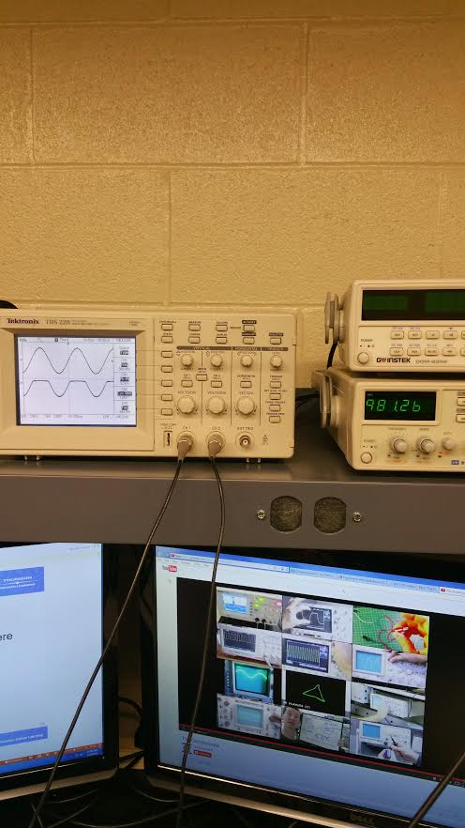
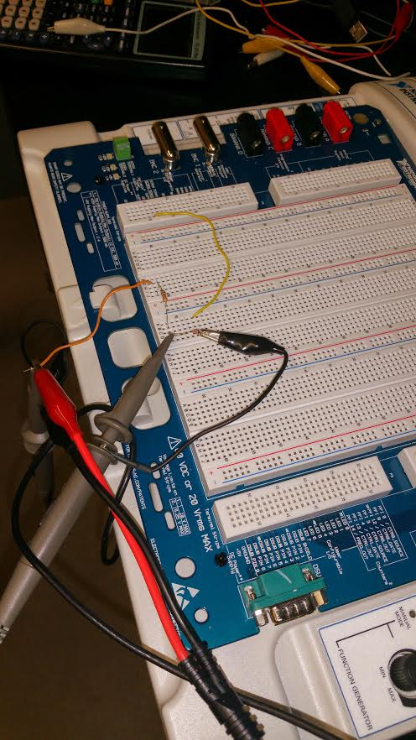
Diode Rectifier (created half wave)
Convert AC power source to DC

Slide 8
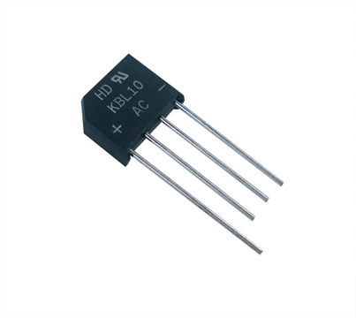
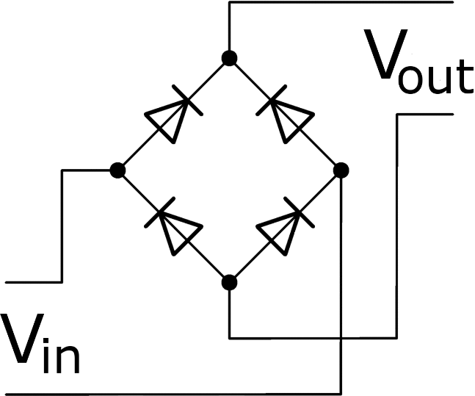
Bridge Rectifier
Output
AC input
Output

Slide 9
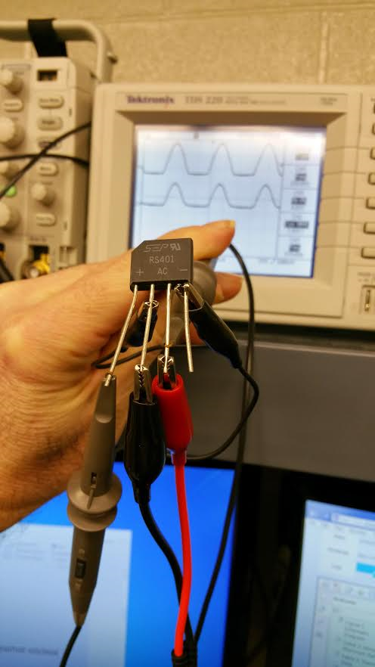
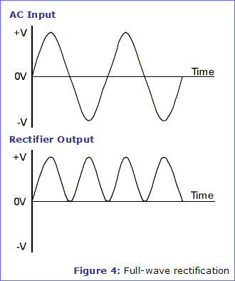
Summary
Our desire result was the graph on the left , our real result was actually on the right. We were sure that we applied voltage input correctly and measure output correctly. This may have been from not adjusting the oscilloscope correctly. We did learned overall how the bridge rectifier should operate. It passes through two diodes with one polarity and then through two different diodes when the polarity is reversed, outputting a constant wave.

Slide 10
Bipolar Junction Transistors
Objective
To understand how a transistor operate
Equipment and Material
DMM,2N3904 transistor, (2) 10k resistors, 1k resistor, 470ohm resistor, and Elvis
Research and Information
Youtube video and book

Slide 11
Mathematically
PHTSICAL EXPERIMENT RESULTS
5 VOLT SOURCE DIVIDED BY 20 OHMS MATHMATICALLY
RESULTS .25mA
VRC
Actually result was 250 uA
VR2
VR2= 10k*.25uA= 2.5V (actual 2.4177v)
VRE= 2.5V-.7V= 1.8V (actual 1.78v)
IRE=1.8V/1k=1.8mA
VRC= 470K*1.58mA=.846V (actual .8305V)
VCE=VCC-VRC=2.354V (actual 2.3072v)
VRE
IRE

Slide 12
Book examples BJT – NPN Transistor in multisim (Open/Close)

Slide 13
Conclusion
The outputs of voltage and amperage applied and measure to the transistor operated almost identical to what we had predicted.
The two 10k ohm resistor acted as a voltage divider input into the base of a transistor. The results of this 2.5v impression on the transistor was measured at different point.

Slide 14
BJT Amplifier Circuits
Objective
To look at different amplifier configurations and recognize the gain outputs created from the different inputs.

Slide 15
Schematic for current gain type Amp

Slide 16
Conclusion
Different type of setup produce different output result
The capacitors are recognized as being very important in the amplifier circuit.
There was phase reversal from the input to the output.

Slide 17
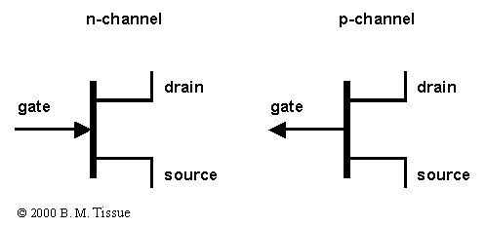
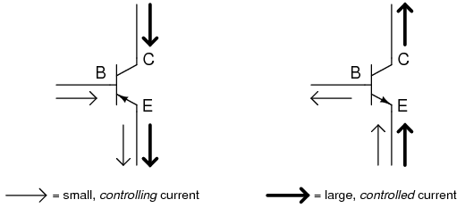
Field-Effect Transistors and Circuits
Objective
Comparing the field effect transistor to the BJT
Field Effect Transistors
BJT

Slide 18
Conclusion
Though the JFET is similar to the BJT, they operate almost opposite.
In BJT, increase in base input result in lower resistance where in JFET, increase input to the gate will eventually pinch-off the JFET.

Slide 19

Operation Amplifier

Slide 20
inverting
Equation:
Av = - (Rf/Ri)
Positive grounded equal the value of the input signal.
The negative sign indicated the output is inverted from the input signal.
Ri
Rf
Input signal applied to inverting input through Ri and the inverted output feeds by through Rf.

Slide 21
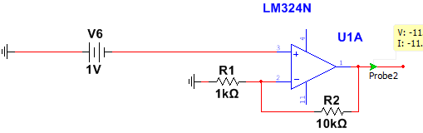
Non-inverting
Equation:
Av = (Rf/Ri) + 1
The junction of the feedback resistor (Rf) and the input resistor (Ri) are still on the negative terminal.

Slide 22
Summary and Conclusion
The inverting amplifier use the negative terminal for the source input and the positive terminal as a ground. Conversely, the non-inverting uses the positive terminal as the source input but the Rf and Ri are still connected in the same negative terminal.
Both amplifier are similar in that they both have a voltage gain at the output though it may be positive/negative.

Slide 23
Oscillator

Slide 24
schematic

Slide 25
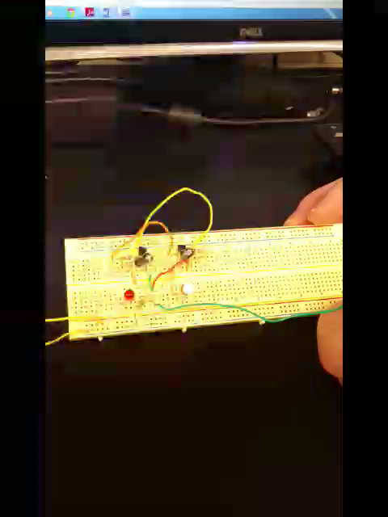

Good YouTube videos we found
With function generator
Without function generator

Slide 26
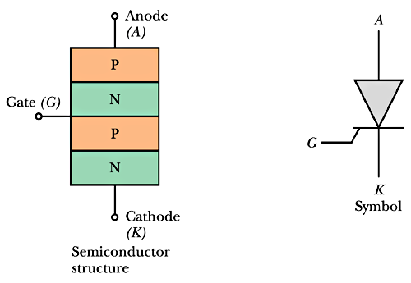
Silicon-Controlled Rectifier (SCR)

Slide 27
Schematic

Slide 28
Summary and Conclusion
These devices need a main source to operate but are actually activated by very minimum input.

